Slide 1

Invest in Maglaj
Invest in Opportunities
MAY 2019

Slide 2

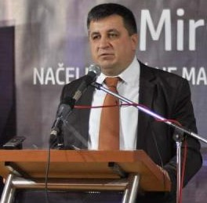
Dear,
As the mayor of the Municipality of Maglaj I wish to welcome you to our little guide., which was made to inform you, as well as, give you a brief outline of the benefits and opportunities Maglaj has to offer.
It is our intention to create a friendly business environment for local but also foreign investors, that express a desire to invest in Maglaj. As the local administration we are fully aware of the importance of investors and are continuously working on improving our services and see it as our duty to ensure that you can grow your businesses without hindrance. A reliable long-lasting partnership, that will benefit your enterprise and our community is a goal we all strife for.
I am certain that together we can achieve many things and create an environment that ensures expansion, numerous opportunities and mutual benefits.
Yours truly,
Mirsad Mahmutagic
Mayor of Maglaj

Slide 3
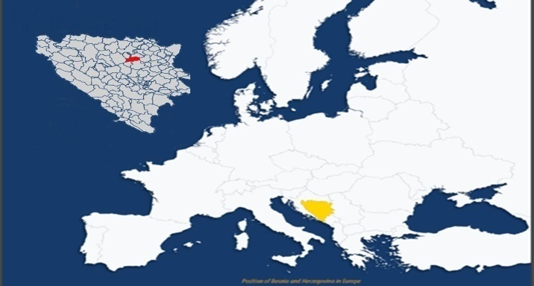

General Information
Official Name | Municipality of Maglaj
Administrative affiliation | Bosnia & Hercegovina, Federation of BiH
Population | 23’146
Adress | Viteska 4, 74250 Maglaj
Telephone | (+387) 032/465-810
Email | opcina@maglaj.ba
Web | www.maglaj.ba
Mayor |  | Dep. Of Local Development
Mirsad Mahmutagic |  | Nermin Beslagic
Telephone | (+387) 032/465-810 | Telephone | (+387) 032/465--823
Email | nacelnik@maglaj.ba | Email | nermin.beslagic@maglaj.ba
Dep. Of Local Development |  | Dep. Of Local Development
Ferhat Bradaric |  | Omar Fazlic
Telephone | (+387) 032/ 465-821 | Telephone | (+387) 032/ 465-823
Email | ferhat.bradaric@maglaj.ba | Email | omar.fazlic@maglaj.ba

Slide 4
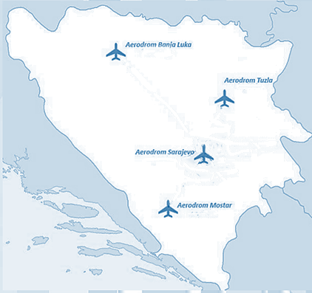
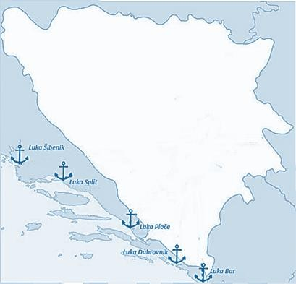
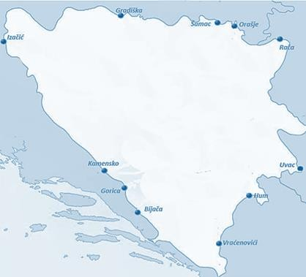
Europe within reach
Sarajevo | 125 km
Tuzla | 88 km
Banja Luka | 128 km
Mostar | 234 km
Sibenik | 326 km
Split | 278 km
Ploce | 303 km
Dubrovnik | 353 km
Bar | 400 km
Samac | 89 km
Orasje | 110 km
Raca | 194 km
Uvac | 250 km
Hum | 215 km
Vracenovici | 346 km
Bijaca | 278 km
Gorica | 226 km
Kamensko | 215 km
Izacic | 271 km
Gradiska | 147 km

Slide 5
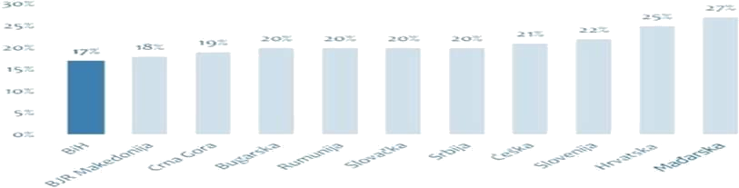
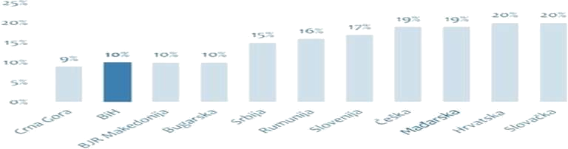
Bosnian Tax System
Lowest VAT in the Region
Inviting Income Tax

Slide 6

WHY MAGLAJ
Wide range of skilled
workforce
Industrial tradition
Business Friendly Environment
Satisfaction of Current Investors
Geo-Location
Expenditures among the lowest in Europe

Slide 7
WORKFORCE

Slide 8

EDUCATION
Available Labour by Gender & Education
KV
PKV KV VKV SSS VŠS VSS
1857
145
1488
14
677
10
144
500
1000
1500
2000
0

Slide 9








Available Labour by Age
3000
2677
2500
2000
1511
1500
1000
500
162
0
18 - 35
36 - 60
61 - 65

Slide 10
UNIVERSITIES
Zenica Univerity – Mechanical, R&D in Metal Sector
Tuzla University – Technical & Natural Sciences
Doboj University – Transportation & Business
Banka Luka University – Electrical Engineering, Mechanical Engineering
Technology
Sarajevo University – Electrical Engineering, Mechanical Engineering
Economics & Business

Slide 11
INVESTMENT
LOCATIONS

Slide 12
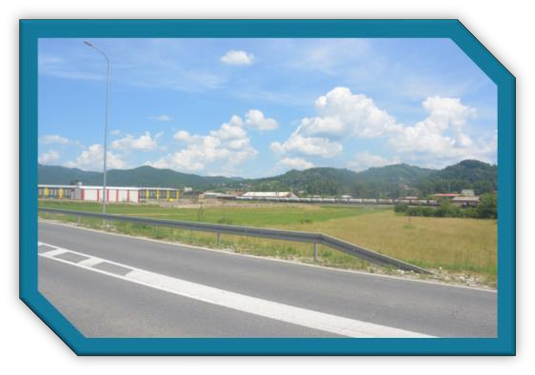
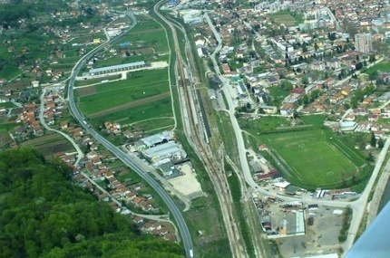
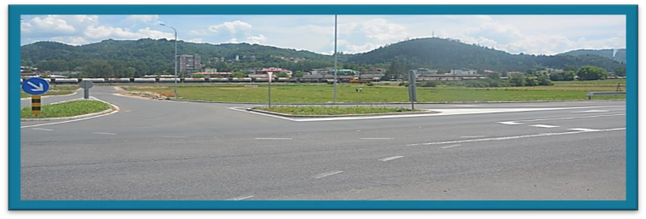
Greenfield Locations
Misurici
Type | Greenfield
Location | Misurici, 74250 Maglaj
Adress | Misurici bb
Concact | Nermin Beslagic nermin.beslagic@maglaj.ba (+387) 032/465-823
Infrastructure
Size | 6 ha
Estimated Value | 25 Euro/m2
Electricity | Available
Gas | Not Available
Water | Available
Drainage | Available
Waste Disposal | Available
Telecommunications | Available
Ownership | Privat
Connections
Highway | 0 km (M-17)
Railroad | 0 km
Airport | Sarajevo 125 km Tuzla 88km
City Centre | 0.1 km
Zenica | 56 km
Road Condition | Good

Slide 13

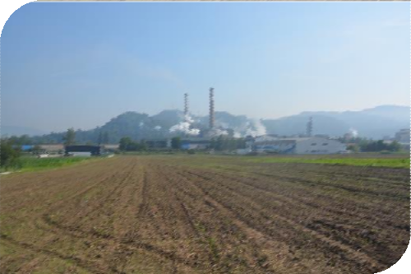

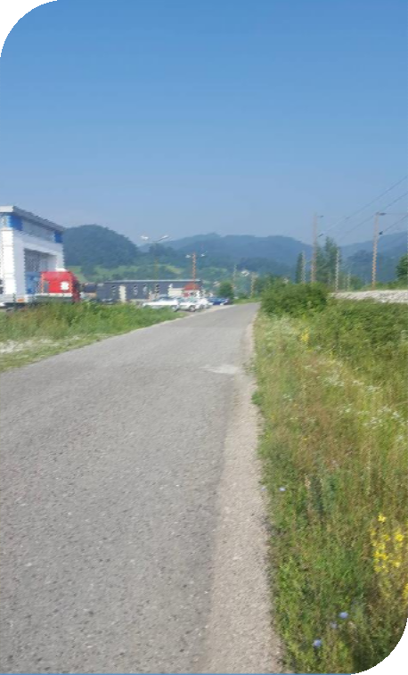
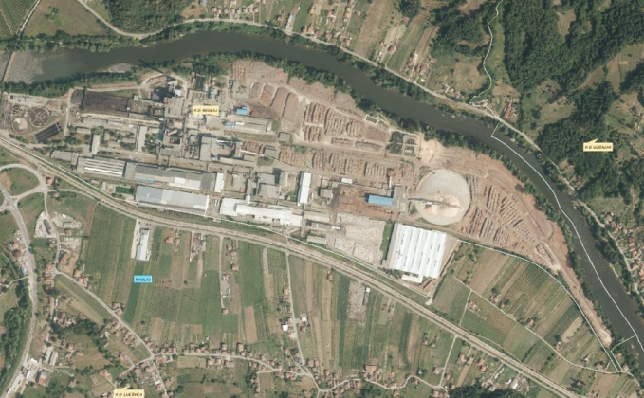
Lijesnica
Type | Greenfield
Location | Lijesnica, 74250 Maglaj
Adress | Lijesnica bb
Concact | Nermin Beslagic nermin.beslagic@maglaj.ba (+387) 032/465-823
Connections
Highway | 0 km (M-17)
Railroad | 10 km
Airport | Sarajevo 130 km Tuzla 90km
City Centre | 10 km
Zenica | 50 km
Road Condition | Good
Infrastructure
Size | 14 ha
Estimated Value | 8 – 11 Euro
Electricity | Available
Gas | Not Available
Water | Available
Drainage | Not Available
Waste Disposal | Available
Telecommunications | Available
Ownership | Privat

Slide 14

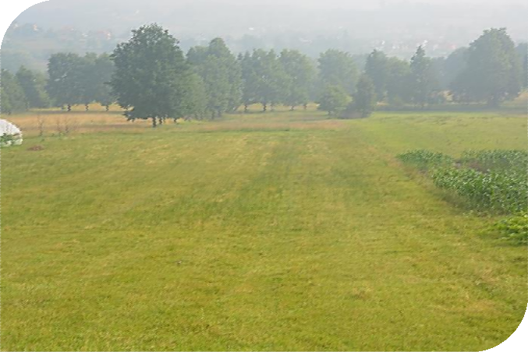
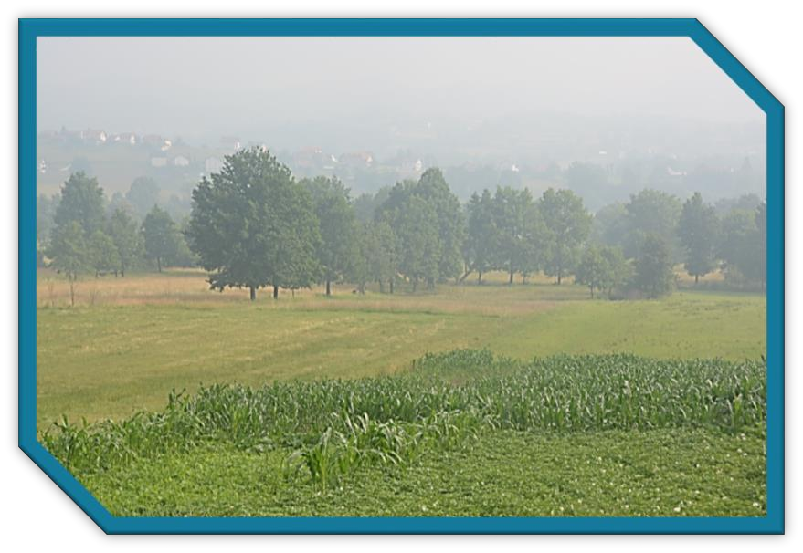
Novi Seher
Type | Greenfield
Location | Novi Seher, 74250 maglaj
Adress | Novi Seher bb
Concact | Nermin Beslagic nermin.beslagic@maglaj.ba (+387) 032/465-823
Infrastructure
Size | 16 ha
Estimated Value | 10 – 13 Euro
Electricity | Available
Gas | Not Available
Water | Available
Drainage | Not Available
Waste Disposal | Available
Telecommunications | Available
Ownership | Privat
Connections
Highway | 0 km (M-17)
Railroad | 10 km
Airport | Sarajevo 120 km Tuzla 88km
City Centre | 3 km
Zenica | 57 km
Road Condition | Good

Slide 15
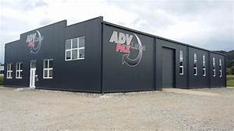
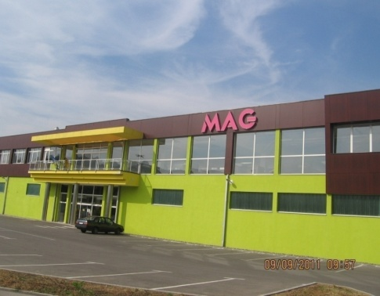
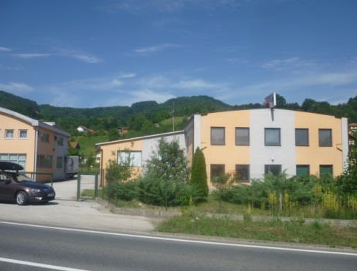
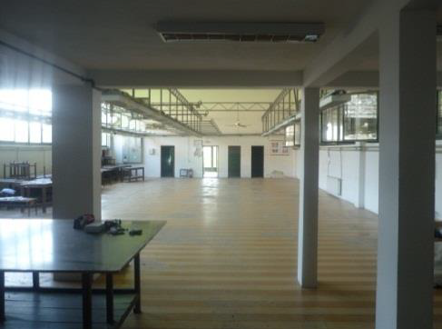
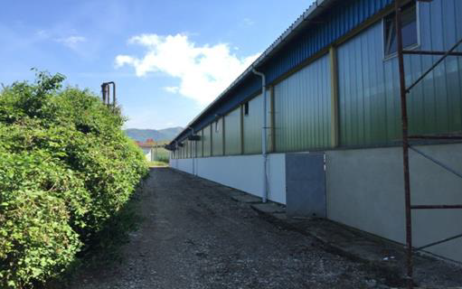
Brownfield Locations

Slide 16
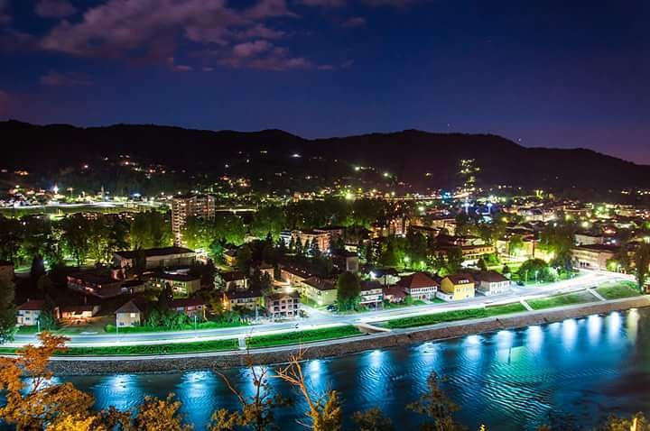
QUALITY OF LIFE

Slide 17
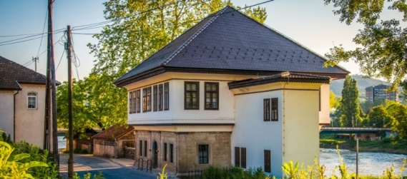
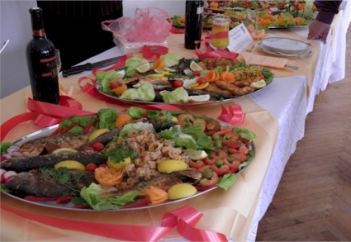
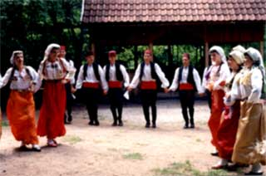
Rich in culture & history
Natural beauties to discover
Library Maglaj with over 30‘000 pieces, which makes it one of the best equipped libraries in BiH.
Yearly student festival, Maglaj Fest for culinary enthusiasts, folklore and many more
Fishing, Hiking, Mountain biking and other outdoor activities
The pleasures of Maglaj lie within the small things, the details that our culture and history have to offer, making it a family friendly, warm and welcoming town.

Slide 18
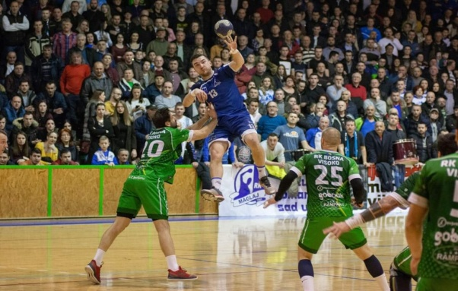
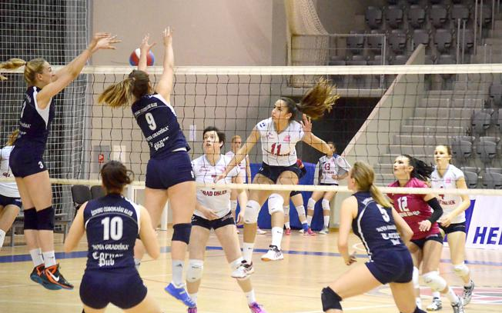
Sport
Maglaj has 19 active sports clubs rangig from popular ball sport like Volleyball, Football, Handball, Basketball up to water sport like Kayak-Canu.

Slide 19

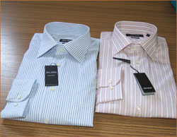
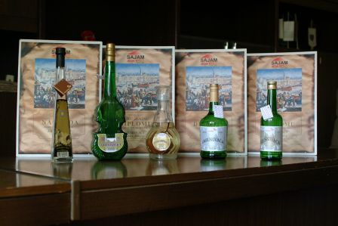
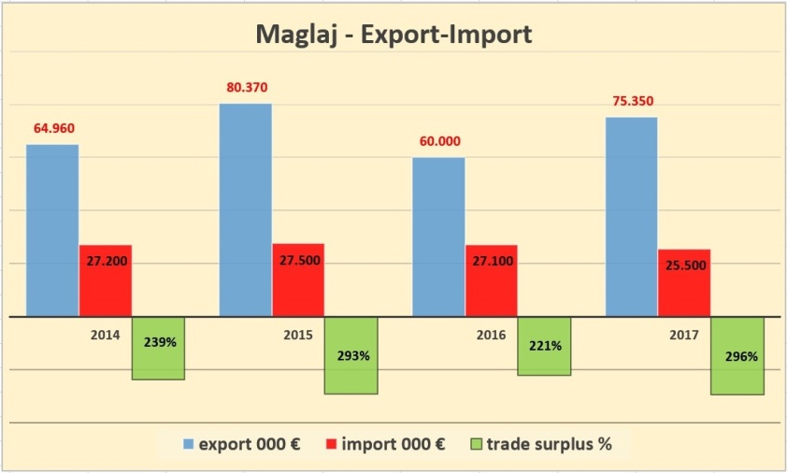
Maglaj has about 897 registered businesses of which 369 are crafts and shops of different services:
Textile Industry
Metal Industry
Furniture Industry
Woodwork Industry
Production of milk and milk products
Construction
Transport
Services and others
Export Oriented Businesses

Slide 20
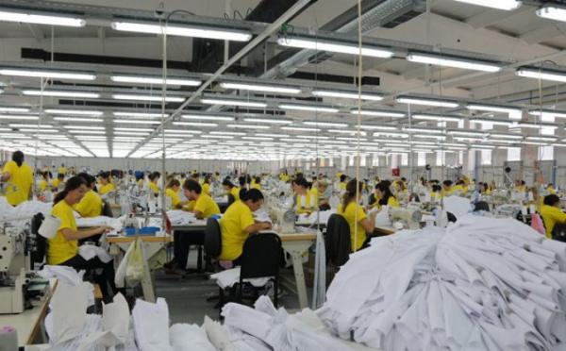
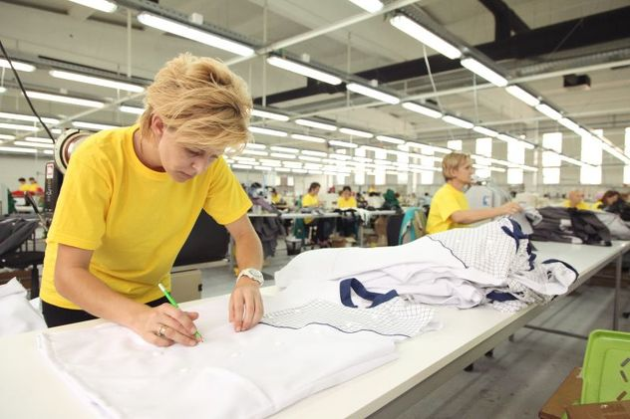
TEXTILE INDUSTRY
The textile industry is one of the most prominent industries in Maglaj. With 3 major textile manufacturers who employ over 700 workers, textile provides the biggest amount skilled workforce.
Over 700 employees
90%-100% Export
200 workers
available
Education of Workers

Slide 21


Successful Stories
Bontex d.o.o. Maglaj one of the leading manufacturers of women and men shirts in BiH with 100% of its products being exported to foreign markets.
The company Fine Life Group d.o.o. Maglaj employs over 100 workers and produces women clothing, designing, as well as, manufactures wedding dresses.
HM Promet d.o.o. manufactures protection clothing for the German market. Within almost 5’000m2 it employs around 350 workers and produces over 1700 models, which found buyers like Mercedes, BMW, Nissan and Kia.

Slide 22







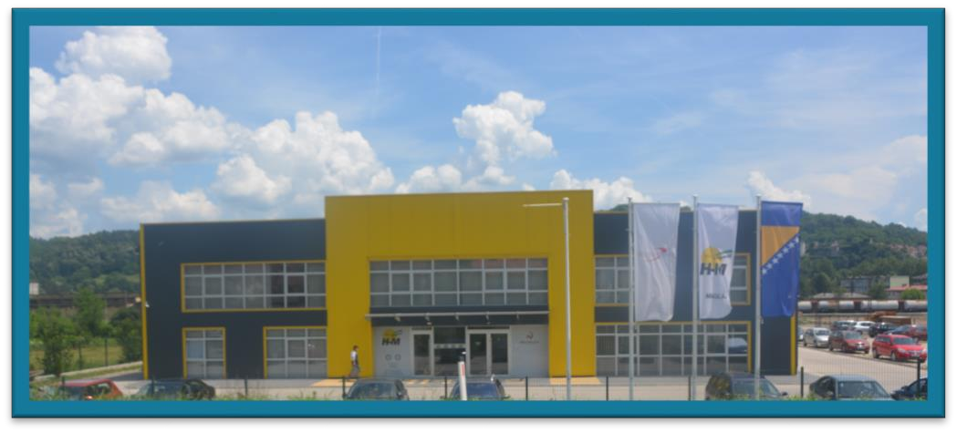
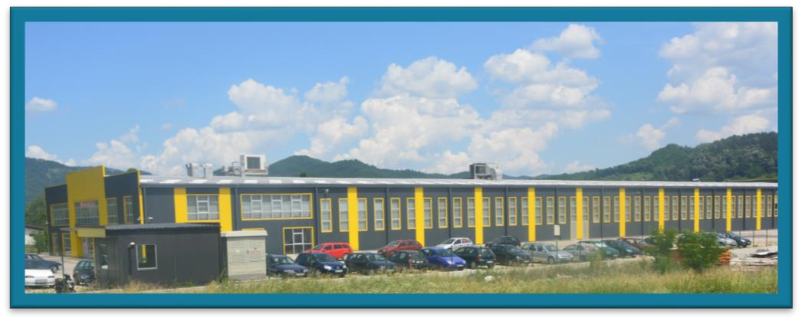
HM Promet d.o.o. produces protective clothing mainly for the German market. With about 5'000 m2 space it employes about 350 workers. Over 1700 models are available and mostly bought by companies like Mercedes Benz, BMW, Nissan, Kia, Maggi and others.
Profile
Founded | 2002
Industry | Textile
Employees | 350

Slide 23

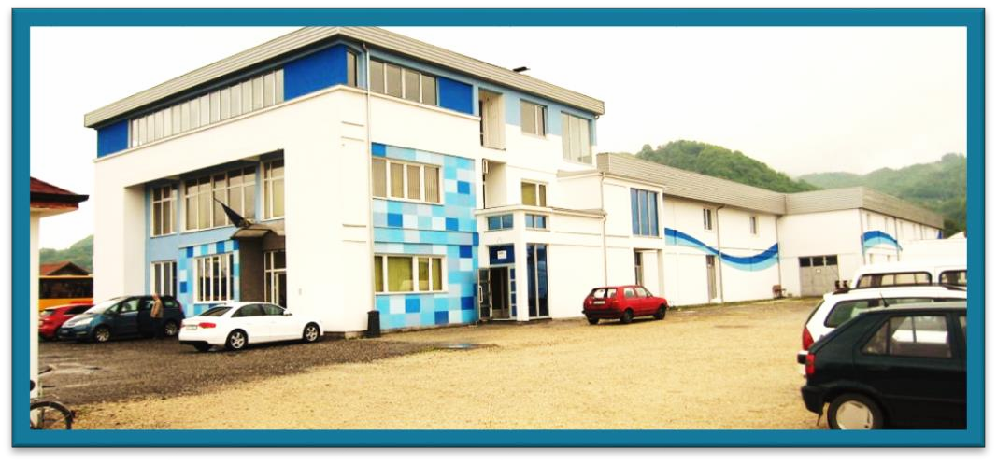
One of the leading manufacturers of women and men shirts in BiH. Exporting 100% of its products to international markets.
Profil
Founded | 2004
Industry | Textile
Employees | 230

Slide 24
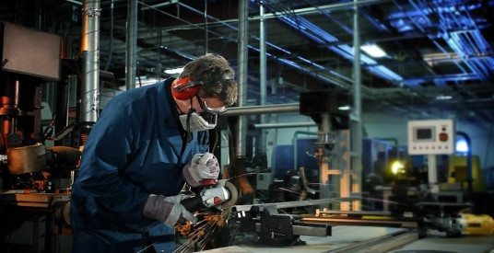
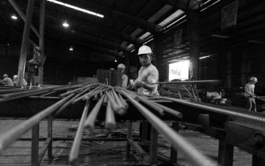
METAL INDUSTRY
The metal industry is one of the most perspective branches in Maglaj. Our tradition and experienced workforce create the foundation for successful investments and continuous growth of businesses
Skilled Workforce
Export oriented
400 available workers
Continuous Education

Slide 25


Successful Stories
Inox Trade d.o.o. Maglaj was founded in 2007, good relations and high quality products combined with low prices are what ensured their growth and customer satisfaction.
The company Baertschi FOBRO is a Swiss investment, which produces agricultural machinery and equipment. The entire production has been moved from Switzerland and Germany to Maglaj.
“Strojna obrada” is a company that produces spare parts for process and other industries. With decades of experience it counts Natron-Hayat as one of their contractors.
Efco nat d.o.o. Maglaj was founded in 1998 as a joint venture with the company EFCO Maschinenbau GmbH, Dueren Germany.
Efco nat – provides specialized services in the examination and

Slide 26
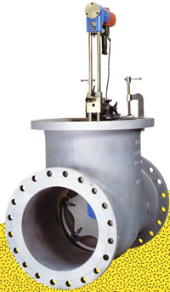
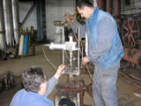
Efconat d.o.o. Maglaj
Efco nat d.o.o. Maglaj was founded in 1998 as a joint venture with the company EFCO Maschinenbau GmbH, Dueren Germany.
Efco nat – provides specialized services in the examination and repair of valves and armature in:
thermal power plants
hydro power plants
industrial heating power plants
refineries
chemical industry
paper-cellulose industry

Slide 27
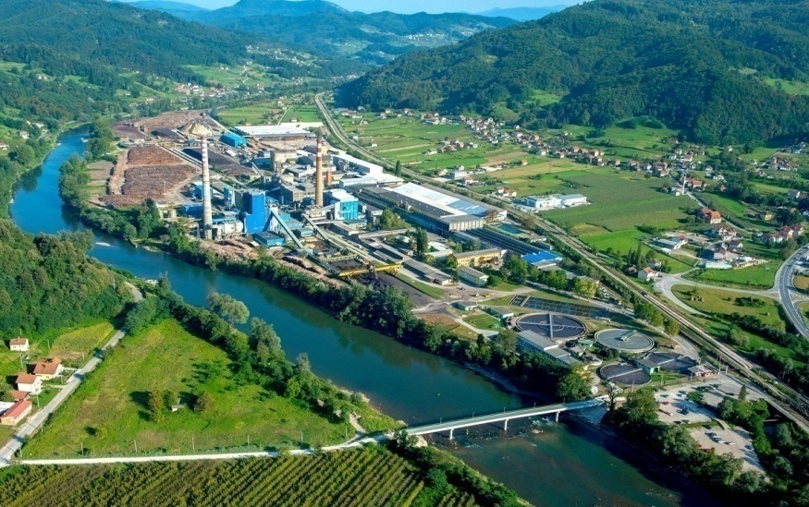
OTHER RELEVANT INDUSTRIES
Next to the metal and textile industries Maglaj is proud to have the biggest producer of paper and cellulose in BiH. Natron was privatized by the Turkish company “Kastamonu Entegre” with an investment of over 100 million € and employs 900 people

Slide 28



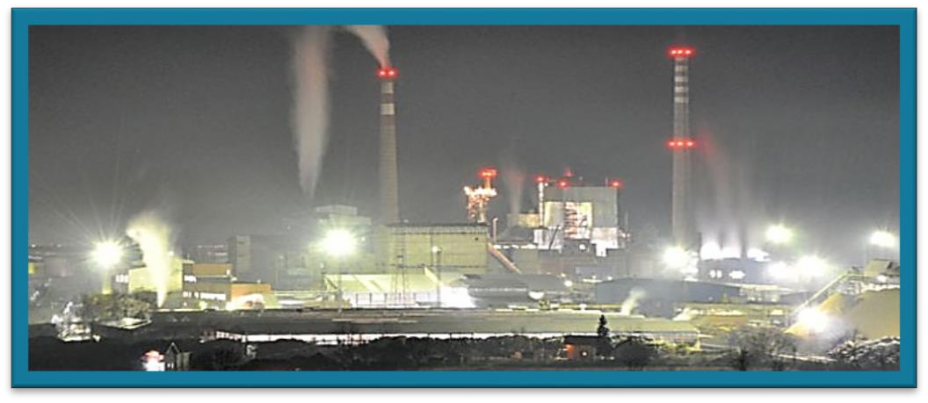
Founded in 2005 through a joint venture Between the companies Natron d.d. Maglaj and Kastamonu Entegre (TR). The new formed Company inherited a 50-year old tradition in Paper manufacturing, based on the previous work of Natron d.d. Maglaj.
Profil
Founded | 15.04.2015
Industry | Paper Manufacturing
Employees | 900 +

Slide 29

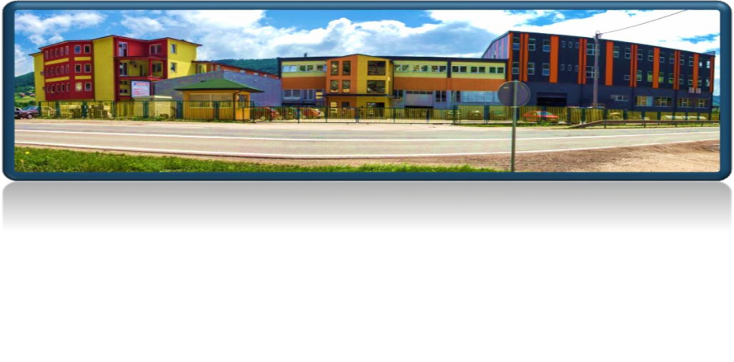
Head quartered in the United Kingdom, Excel Assemblies opend its doors in Maglaj for the manufacturing of cable harness assemblies, wire harness assemlies, associated sub assemblies and sub systems.
Profile
Founded | 2014
Industry | Car/Aviation
Employees | 500

Slide 30
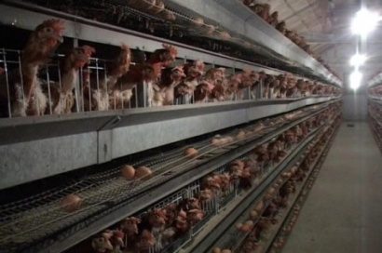
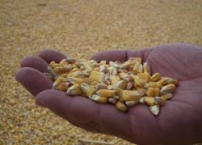
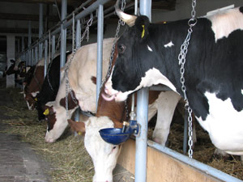
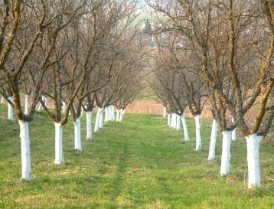
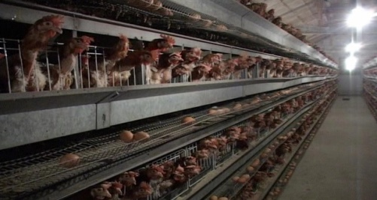
AGRICULTURE
Incentives for agriculture:
All forms of agricultural production
All levels of government
Possibilities to enlarge agricultural capacities:
Cold storages
Drying storages
Food processing facilities(salads, juices, jam and others)
other

Slide 31
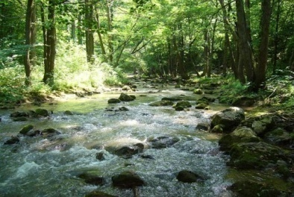
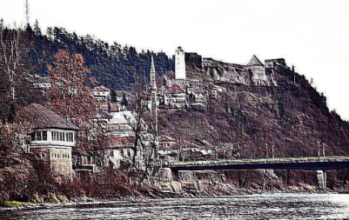
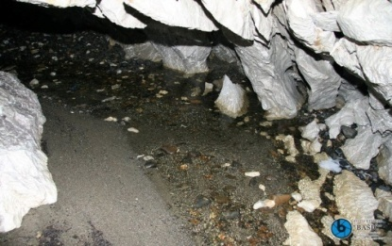
TOURISM
Investment potential to create tourist offers through the use of natural, cultural and historical resources:
Cave Megara
Uzeirbegov konak,
Fortress
Delibegov han
Mountain lodge Ošve
Co-operation with religious communitiesama
Others

Slide 32
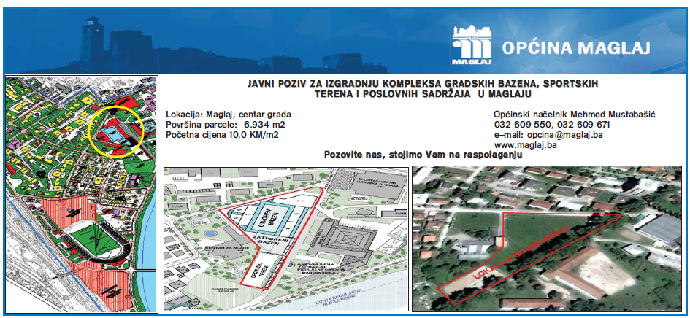
DEVELOPMENT OF INFRASTUCTURE
Pools, Sport fields and other infrastructure as investment opportunities

Slide 33






Why Invest in Maglaj?
Individual Approach
Services of a Local Community
Business Friendly Environment
Satisfaction of Current Investors
Geo-Location

Slide 34
Contact
Municipality of Maglaj
Address: Viteška broj 4,74250 Maglaj
Tel: +387 (0) 32 / 465-810
Mayor
Mr.sci. Mirsad Mahmutagic, dipl.ing.el.tehn.
Tel: +387 (0) 32 / 465-811
Investors Contact
Nermin Bešlagić & Ferhat Bradarić
Tel: +387 (0) 32 / 465-823
+387 (0) 32 / 465-821
E-mail: nermin.beslagic@maglaj.ba
Email: ferhat.bradaric@maglaj.ba

Slide 35



opcina@maglaj.ba
www.maglaj.ba
facebook.com/Općina-Maglaj

